Slide 1
Predicting the Probability of Forest Fires using Weather Data
Group Members:
Parviz Subkhankulov (ps310@duke.edu)
Temirlan Sabyrbayev (ts429@duke.edu)
Nazirjon Ismoiljonov (ni33@duke.edu)

Slide 2

Introduction
Problem description
Forest Fires
Climate Change -> Warmer and Drier conditions
Temperature
Soil moisture
Presence of trees
The purpose for the project
Developing a model that can be trained and used for Forest Fires Prediction for certain day, month or a year.
Initial input (Training Data) → Model // only once
Input (mean values of wind, temperature, humidity, precipitation, soil-water content, solar radiation) → Model → Danger level of Fire occurring.

Slide 3
Background
Related Information
Background
Leveraging Machine Learning to predict wildfires using PyTorch Lightning
Predicting California Wildfire Size with Neural Networks
Formula
Fosberg fire weather index
Probability Models of Fire Risk Based on Forest Fire Indices in Contrasting Climates over China
Database
Predicting Wildfires with Weather Forecast Data

Slide 4
Design and Implementation (Plan)
Project design
Flexible and Reusable Prediction Model (Framework)
*Different databases (Given that they adhere to the common framework)
Different locations
Project implementation
Producing or finding a mathematical formula for calculating forest fire danger.
Using past weather forecast to train the prediction model.
Calculating the likelihood and danger of forest fires occurring for future dates.
Visualizing the results so that people can analyze the risk and make decisions.

Slide 5
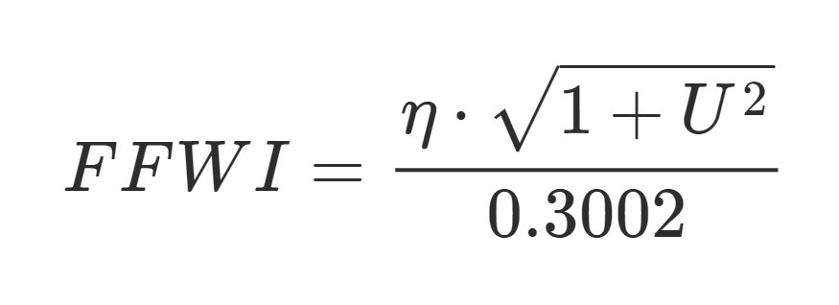
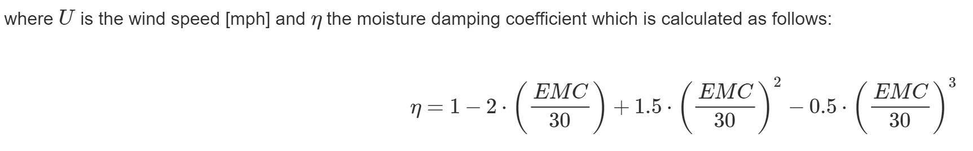
Design and Implementation (Actual)
Research
Formula (Fosberg fire weather index)

Slide 6
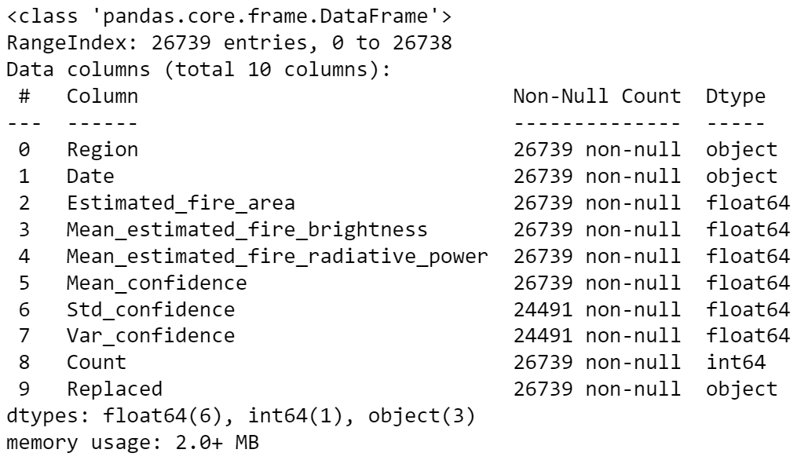
Design and Implementation (Actual)
Research
Database (Predicting Wildfires with Weather Forecast Data)
Historical Wildfires
This wildfire data contains data on fire activities in Australia starting from 2005.

Slide 7
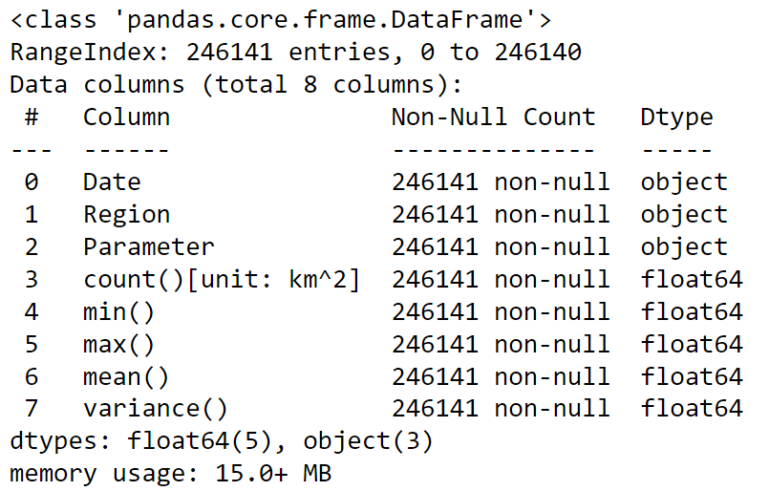
Design and Implementation (Actual)
Research
Database (Predicting Wildfires with Weather Forecast Data)
Historical Weather
Parameter:
Precipitation [mm/day], Relative humidity [%], Soil water content [m**3 m**-3], Solar radiation [MJ/day], Temperature [Cl, Wind speed [m/s].

Slide 8
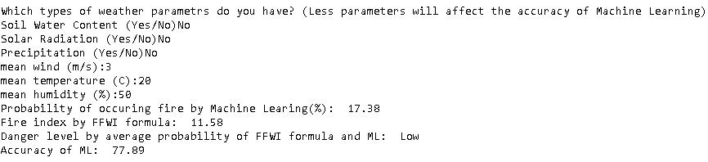
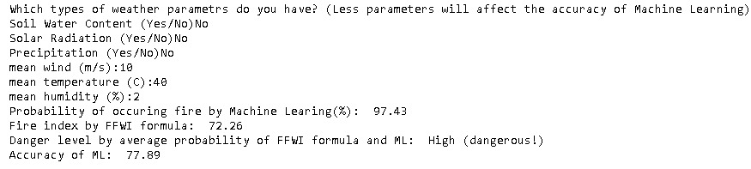
Design and Implementation (Samples)

Slide 9
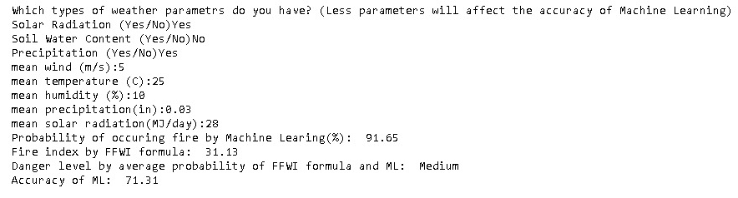
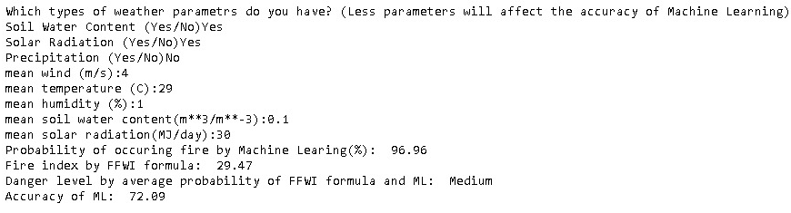
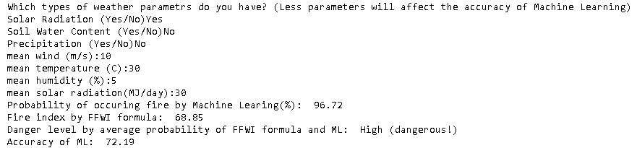
Design and Implementation (Samples)

Slide 10
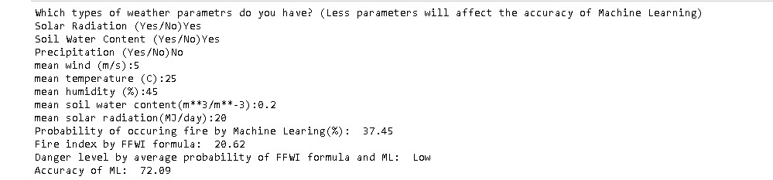
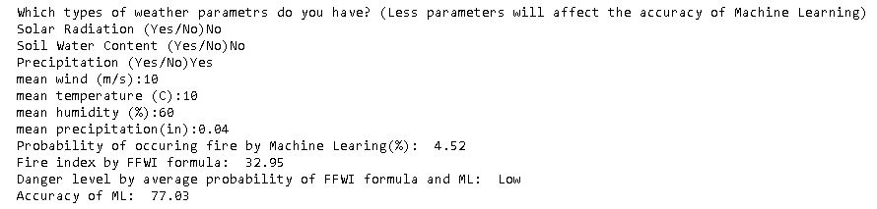
Design and Implementation (Samples)

Slide 11
Timeline
Day 1-3
Job 1 Research
Day 4-7
Job 2 Theory & Algorithm Model Building
Job 3 Data Selection
Day 8-12
Job 4 Data Cleaning
Job 5 Forest Fires Prediction Model Training
Day 13-17
Job 6 Prediction Analysis with Graphs
Job 7 Code Design
Job 8 Flexible Database

Slide 12
Group Member Contributions (Plan)
Parviz Subkhankulov (Lead)
Project Manager
Research
Project Presenter (Presentation and Written Report)
Temirlan Sabyrbayev (Technical Side)
Research
Code Building
Model Building
Nazirjon Ismoiljonov (Visual Side)
Research
Code Builder
Visualization Creator

Slide 13
Q&A
Thank you!
Parviz Subkhankulov (ps310@duke.edu)
Temirlan Sabyrbayev (ts429@duke.edu)
Nazirjon Ismoiljonov (ni33@duke.edu)

